Slide 1

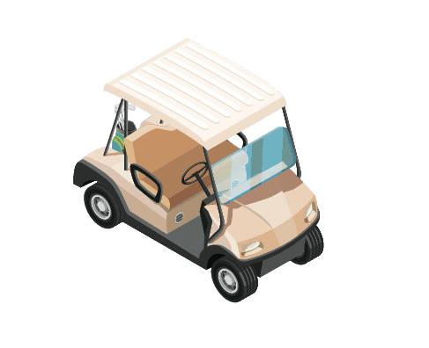


Autonomous Golf Cart Supervisor: Dr.Uvais Qidwai
Hello, I am AZA I will Guide you through your Presentation Today Ready!! Let’s meet the members of this project
Project Group Members: Abdelaziz Shehata (202107370)
Zabin AlDosari (202009034)
Abdulla Musa (202006166)
Hello, I am AZA in my new shape. I will Guide you through your Presentation Today Ready!! Let’s meet the members of this project
Notes:
Good morning everyone and thank you for being here. We are excited to present our senior project today. My name is Abdulla and I am joined by my teammates Zabin and Abdelaziz . Together, we have worked on a project that brings smart technology into real environments in a practical and meaningful way. Our project is called the Autonomous Golf Cart. It is designed to operate without a driver and navigate safely in places such as campuses, golf clubs, and large events. Through this project, we aim to create a transportation solution that is smarter, safer, and more sustainable. This aligns with Qatar’s national vision for innovation and clean mobility. Let us begin by understanding the background and motivation behind this idea.

Slide 2


Table of contents
Before we proceed, let’s figure out the content of our presentation
Introduction
Challenges
High – Level Architecture (Hardware & Software)
Design
Proposed solution
Design constraints
Implementation and Testing
Results
Summery & Conclusion
Future work

Slide 3

Introduction
Sit back, relax, and let me drive you through this presentation, no license required!

Slide 4

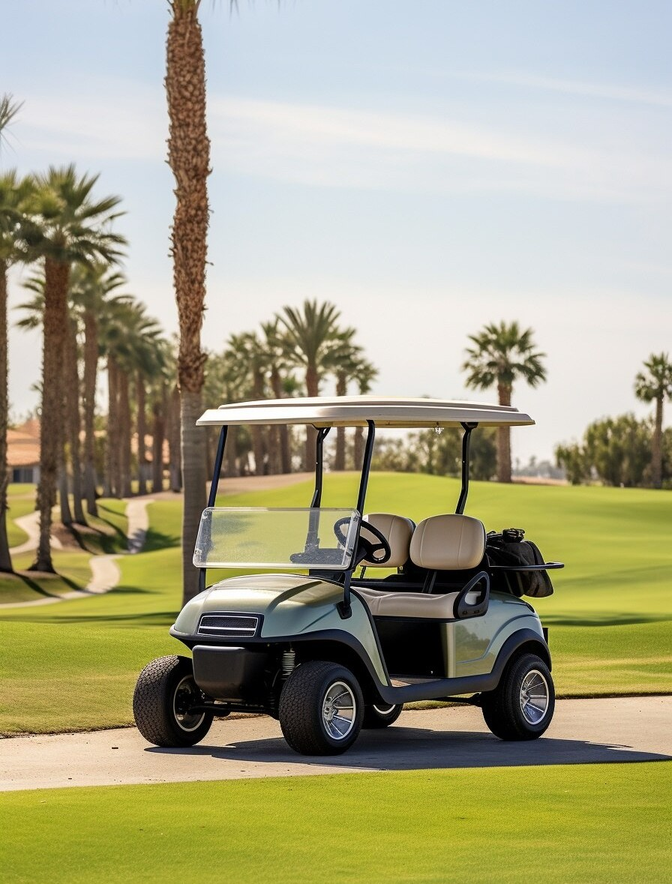
Golf carts play a vital role in controlled environments like campuses, resorts, and large events, offering efficient, low-speed transportation. During the FIFA 2022 World Cup in Qatar, they proved essential in managing personnel and material movement across vast venues. Their adaptability and eco-friendly potential make them an ideal solution for enhancing operational efficiency and sustainability in various settings.
Notes:
Golf carts are already common in controlled environments such as university campuses, resorts, and stadiums. They are small, quiet, and ideal for short trips within limited areas. During the FIFA World Cup 2022 in Qatar, golf carts played an important role in helping staff and organizers move smoothly across large areas.
Such events highlight how useful small vehicles can be in calm and well-managed areas, where everything moves slowly and the roads are simple.
Even though these carts are helpful, most of them still require a person to drive.
This creates challenges such as depending on drivers, facing mistakes, and spending more money on labor.
In our project, we worked on creating a golf cart that moves and drives on its own without needing a driver.
With this system, movement becomes faster, safer, and more friendly to both people and the environment.

Slide 5

Problem Statement
Transportation in controlled environments, such as campuses and resorts, faces challenges:
inefficiency, high operational costs.
Safety risks due to human error, which causes 90% of traffic incidents globally.
Environmental concerns from fossil fuel use.
Haha, Humans
Notes:
Golf carts that rely on human drivers often come with several issues. They require more resources to operate, and they are more likely to be involved in mistakes due to human error. In fact, studies show that over 90 percent of traffic accidents happen because of human mistakes, which makes safety a major concern. Furthermore, many of these carts still run on fuel, which not only harms the environment but also produces noise.
Because of that, they are not the best option for clean and peaceful places such as campuses, parks, or resorts.
For this reason, there is a clear need for a smarter and cleaner alternative. Electric and autonomous systems offer a better solution because they reduce pollution, minimize risks, and operate more efficiently. Therefore, our goal is to build a smart electric cart that drives by itself and make decisions in real time, without relying on a human driver.

Slide 6
Challenges
We had really bad time with the several challenges that faced us last couple months

Slide 7
The project aims to develop a Level 4 autonomous golf cart for controlled environments like campuses and golf courses. By replacing human-operated vehicles, it seeks to reduce labor costs, enhance safety, and improve efficiency while addressing technical and non-technical challenges:
I got your back with these challenges don’t worry
Technical Challenges:
Obstacle Detection and Avoidance
Real-Time Data Processing
Sensor Fusion
Power and Efficiency
System Scalability
Non-Technical Challenges:
User Acceptance and Trust
Regulatory Compliance
Cost Constraints
Maintenance and Support
Notes:
Building this system brought several challenges, both technical and non-technical. From a technical point of view, one of our main goals was to ensure the cart could safely detect and avoid obstacles. To make this possible, we used a combination of LiDAR, cameras, and ultrasonic sensors, all working together. In addition, We had to process the data fast to allow the cart to react quickly to any situation. Power management was also a challenge, as we needed the system to operate smoothly and efficiently. On the non-technical side, we needed to gain trust from users who might feel unsure about autonomous vehicles. We also had to meet safety standards, follow legal requirements, and make sure the system was affordable and easy to maintain. All of these challenges made us try different ideas, fix problems again and again, and use real engineering skills to make the system better.
Through this experience, we developed both our technical skills and our ability to collaborate and solve real-world problems.

Slide 8

Project Objectives:
Develop a Fully Autonomous Golf Cart
Integrate Advanced Sensor Systems
Real-Time Data Processing
Obstacle Detection and Avoidance
Navigation and Path Planning
Cost-Effective Solution
Testing and Validation
Notes:
To solve these challenges, we set clear objectives for our project. Our first goal was to build a golf cart that can work by itself without any help.
It should be able to see what’s in front of it, follow a clear road, and stop or change direction when needed. To achieve this, we selected advanced sensors such as LiDAR for 3D mapping, cameras for vision, and ultrasonic sensors for nearby detection. These sensors allow the cart to understand its surroundings and make smart decisions. We also aimed to process all sensor data in real time using powerful onboard hardware and ROS2 software. This allows the system to react quickly and efficiently while the cart is moving. Finally, we designed the system to be modular and cost-effective. This make it easy to upgrade in the future and suitable for real testing in environments like university campuses. In summary, our objective was to build a smart, safe, and future-ready autonomous golf cart that solves real transportation needs.

Slide 9
High – Level Architecture (Hardware and Software)
Behind every genius robot is a great blueprint. Let me break down the wires and wonders that make me tick

Slide 10
Hardware high-level Architecture
Notes:
Talk about each subsystem and did we used for it

Slide 11
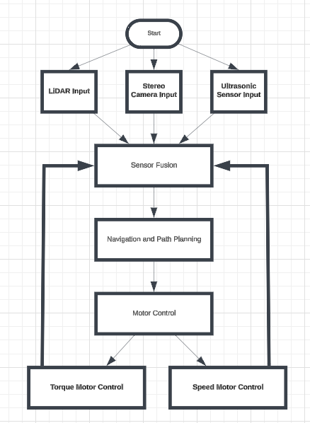
Software high-level Architecture

Slide 12
Design
How will you gather all these hardware together?

Slide 13
System Connectivity
Fun fact: I see better than humans! LiDAR, cameras, sensors you name it, I’ve got it!
Notes:
Jetson
Sensing
Vision
Drivers
Power

Slide 14
Proposed solution

Slide 15
Proposed Solution
To address these issues, a scalable, autonomous golf cart system is proposed, integrating advanced sensors, AI, and electric vehicle technologies to enhance safety, reduce costs, and support sustainability goals.
Notes:
The solution for the problems Abdulla mentioned in the beginning is a

Slide 16
Design constraints

Slide 17

Design constraints
Design constraints
Real-Time Responsiveness
Power Efficiency and Battery Life
Environmental Impact
Safety and Collision Avoidance
Data Security and Privacy
Notes:
Met, The system responds within safe real-time limits.
Not met, Battery life was reduced due to a change in battery capacity and vehicle platform. Further optimization or battery upgrade may be needed to meet original target.
Met, Fully electric; suitable for campus and quiet zones.
Partially Met, Accurate detection in most cases; needs tuning for angular edges.
Met, No security fails

Slide 18
Design constraints
Logistical & Organizational constraints
Limited Time Availability
No Initial Golf Cart Provided
Lack of Team Members
No Initial Workspace
No Financial Sponsorship
Notes:
Limit time, worked in parallel where possible.
We took promesses from companies and the uni, started integration as soon as cart was available
This project is for larger team, Delegated tasks efficiently based on skillsets.
No initial workspace, Supervisor provided a workspace mid-semester.
Used affordable components and leveraged university resources

Slide 19
Implementation and Testing

Slide 20
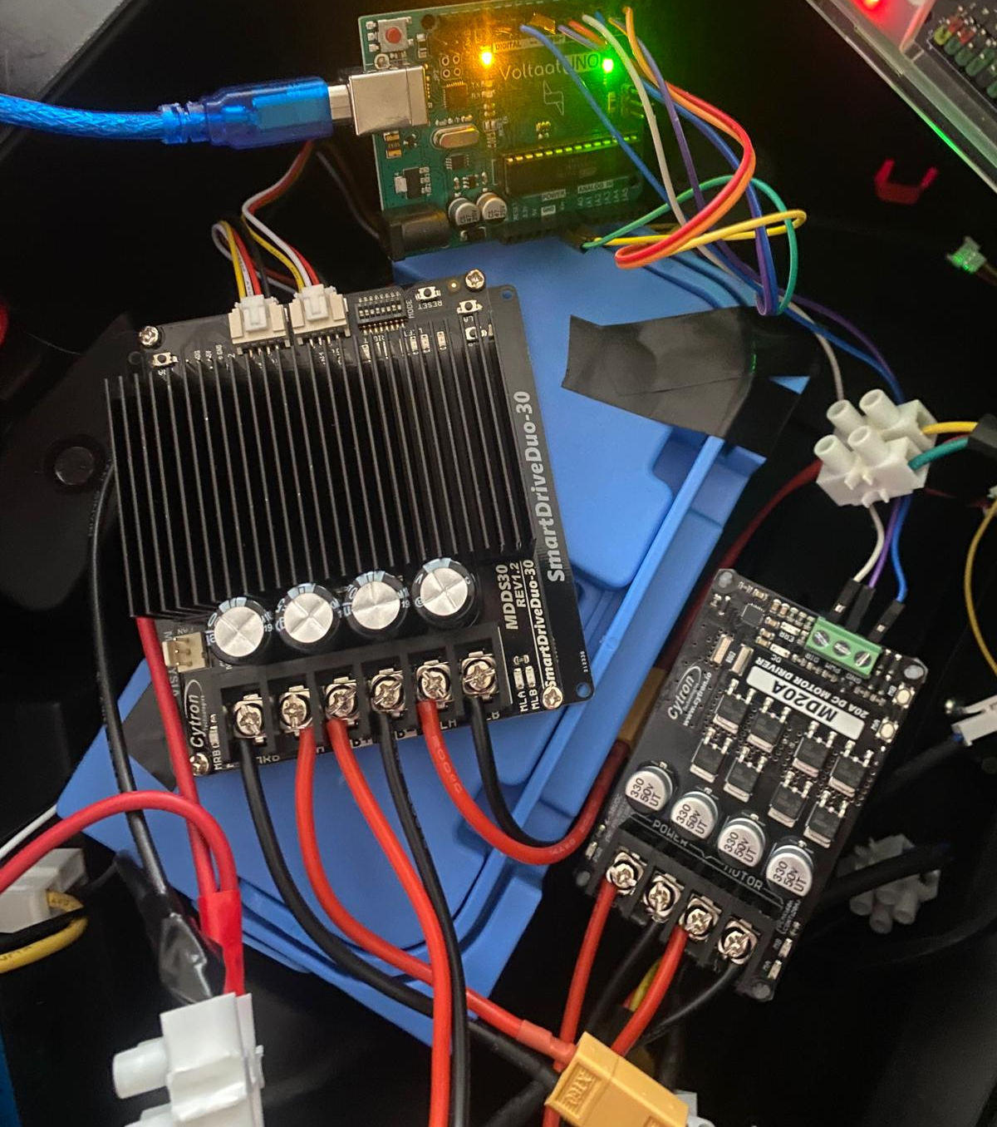
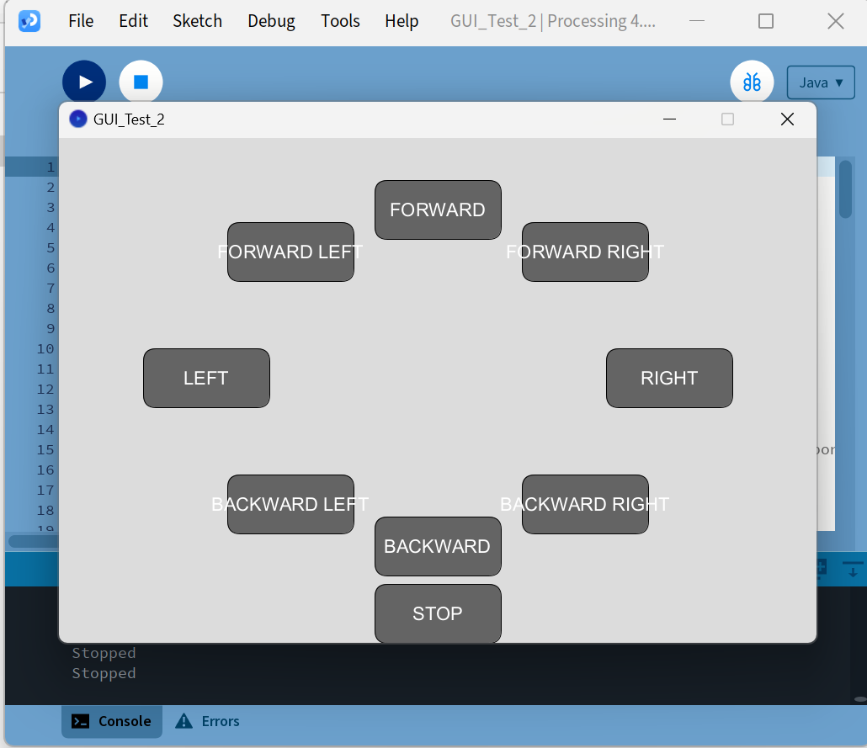
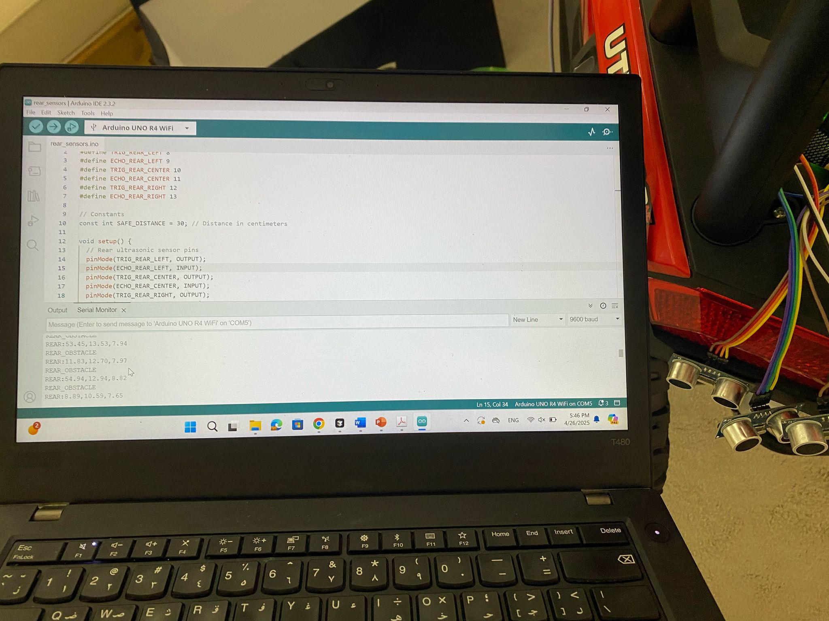
Implementation and Testing Phase 1
Motor Movement Control Using Processing GUI + emergency brakes system
Notes:
Gui
Code for ultra
Drivers

Slide 21
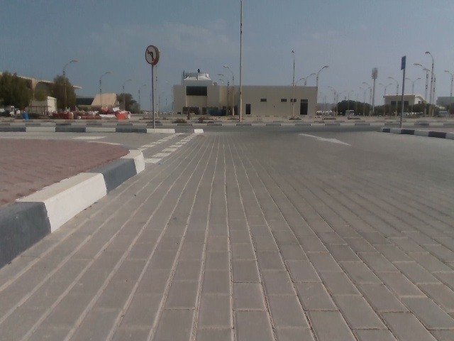
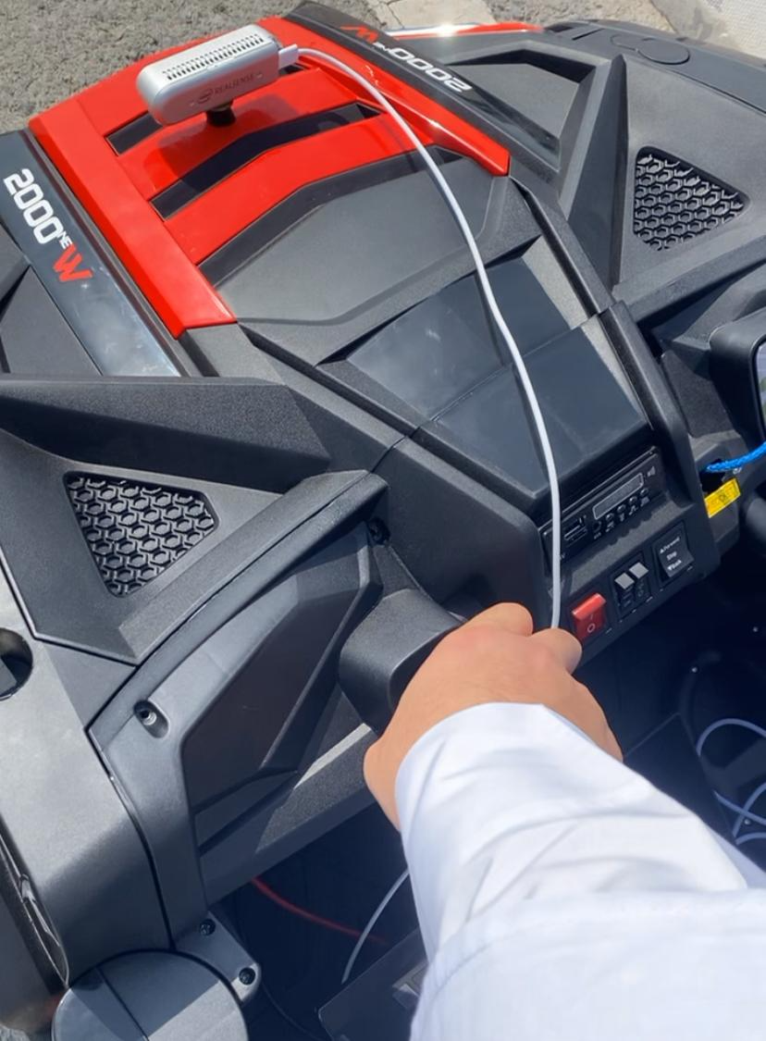
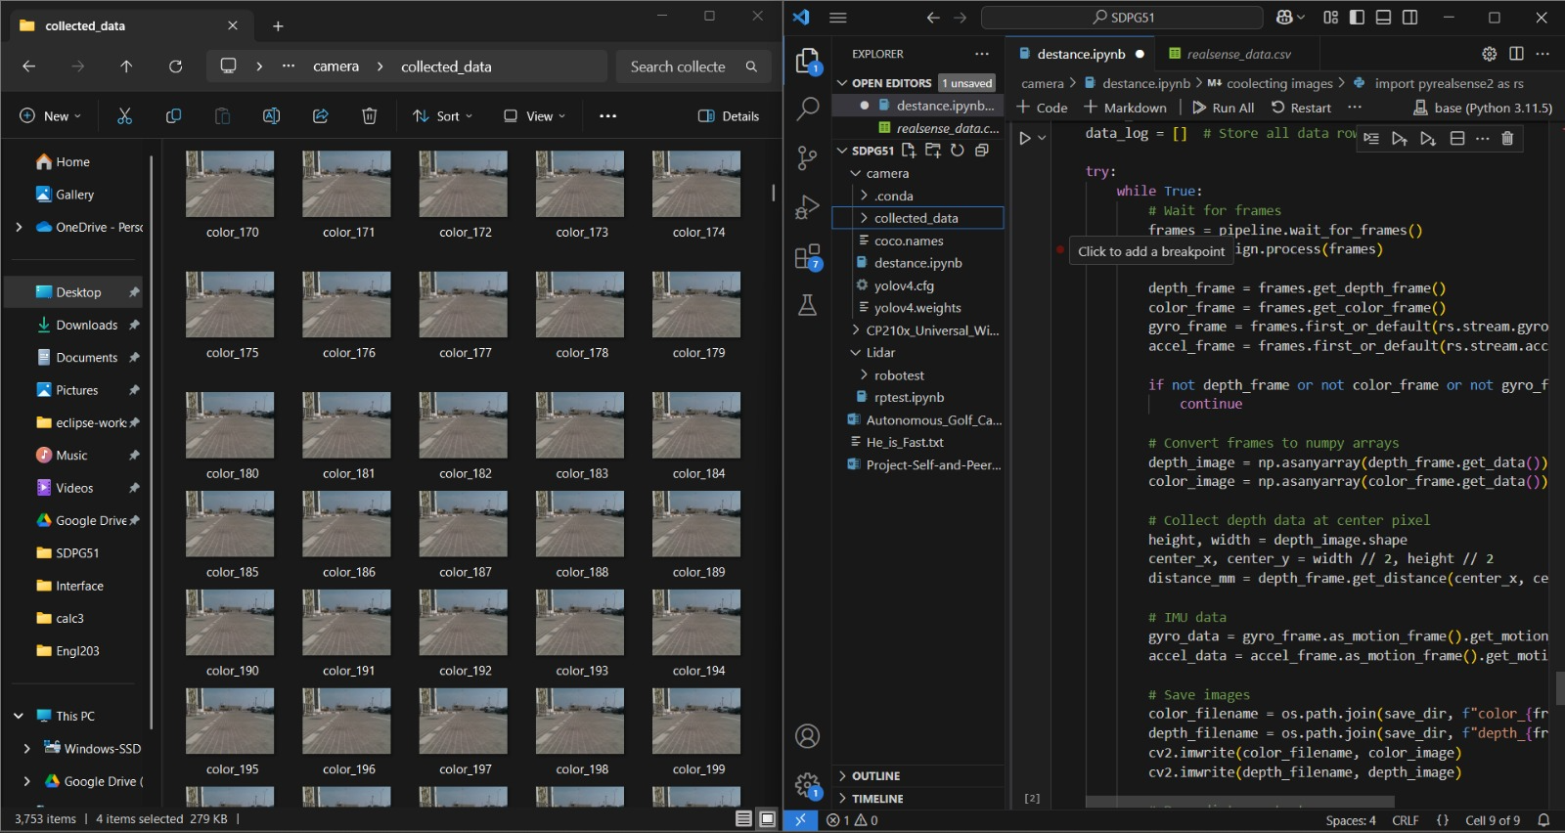
Implementation and Testing Phase 1
Dataset Collection via RealSense for Movement Analysis
Notes:
Code every 0.2 sec
Robo studio

Slide 22
ROS2
ROS 2 used for communication between different parts
Handled real-time sensor fusion (LiDAR, camera, ultrasonic)
Enabled modular, scalable design with multiple nodes
Managed obstacle detection
Used ROS 2 topics for motor control and emergency stop
Visualized sensor data for testing and debugging
Notes:
ROS 2 played a core role in making our golf cart autonomous.
It allowed different parts of the system—like the ultrasonic sensors and the motors—to talk to each other in real time through dds protocol which enable ros2 to communicate on Realtime. We used ROS 2 nodes to process this data and decide how the cart should move. For example, if the ultrasonic sensor detected something very close, the system could immediately trigger an emergency stop using a ROS topic. Thanks to ROS 2, we could also visualize most of the needed systems, which really helped us debug the system and make sure the different subsystems worked correctly. Overall, ROS 2 made our system modular, reliable, and easier to scale.

Slide 23
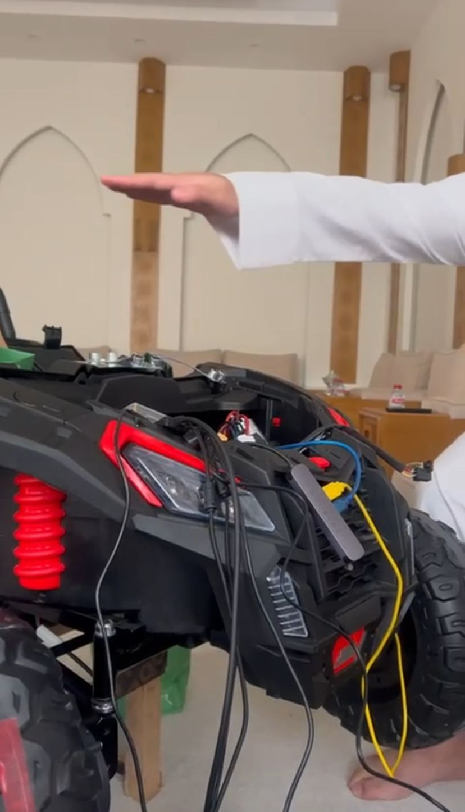
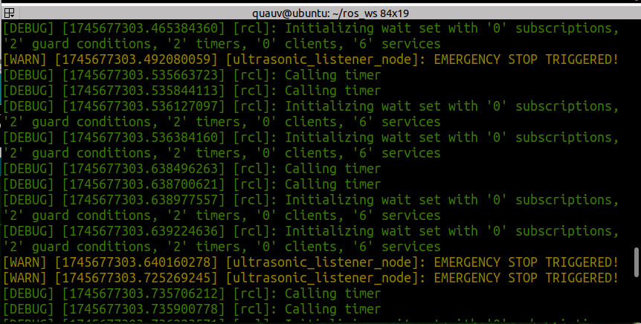
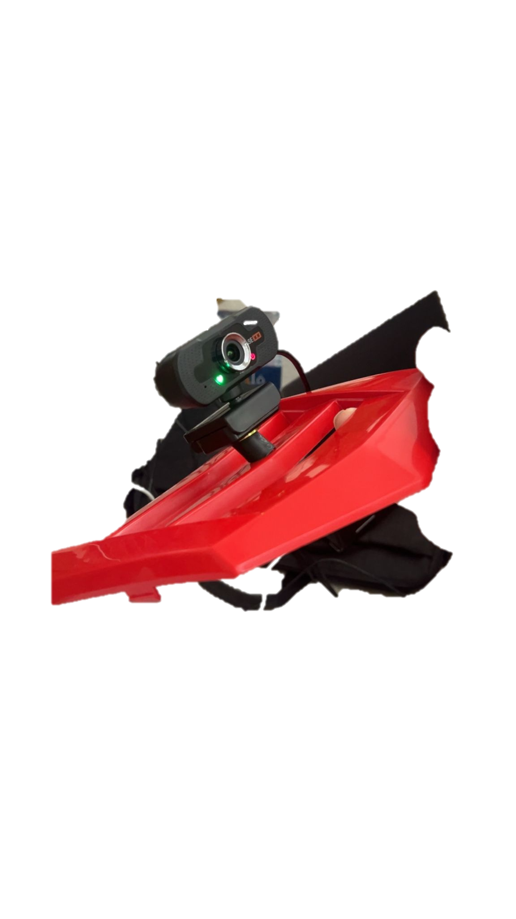
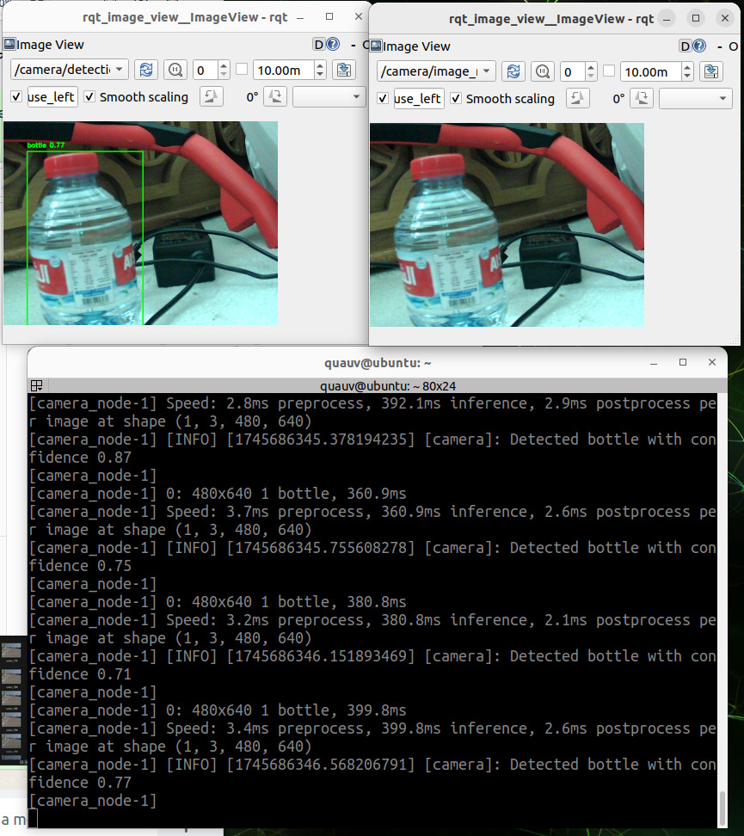
Implementation and Testing Phase 2

Slide 24
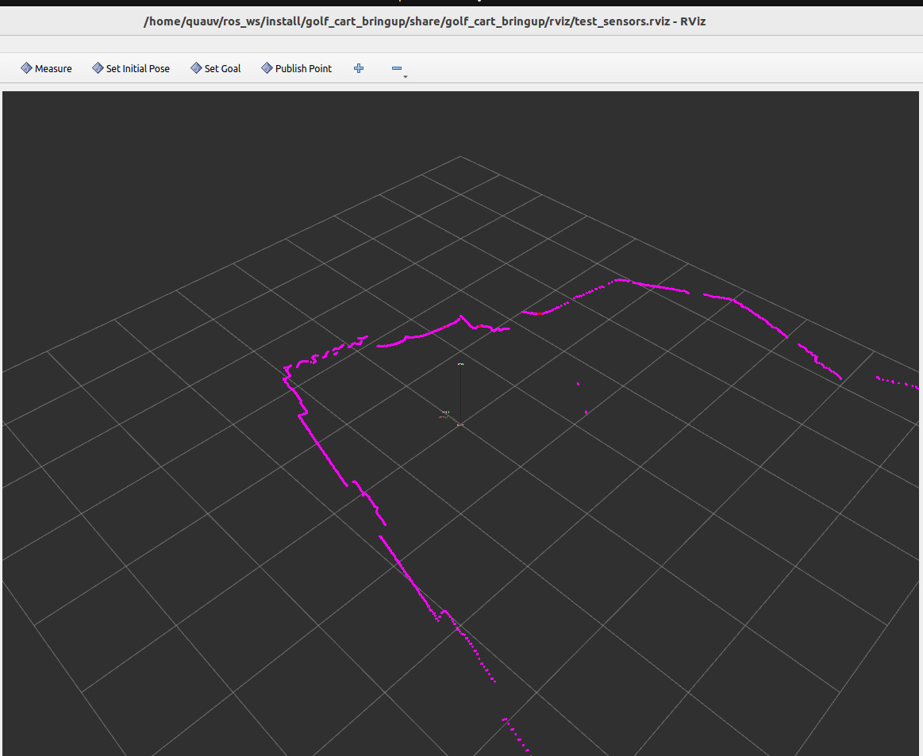
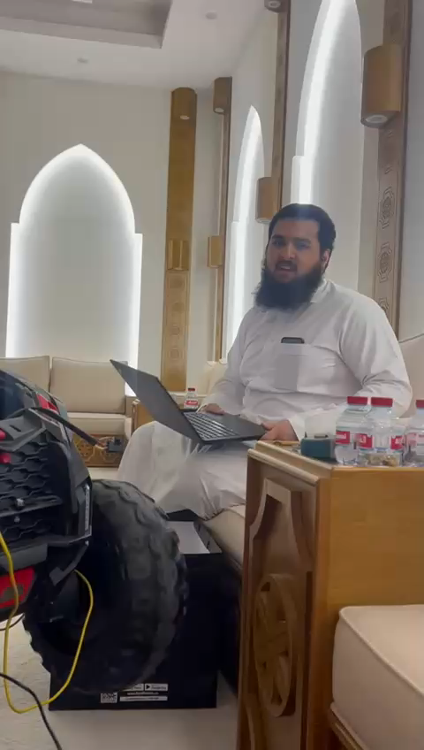
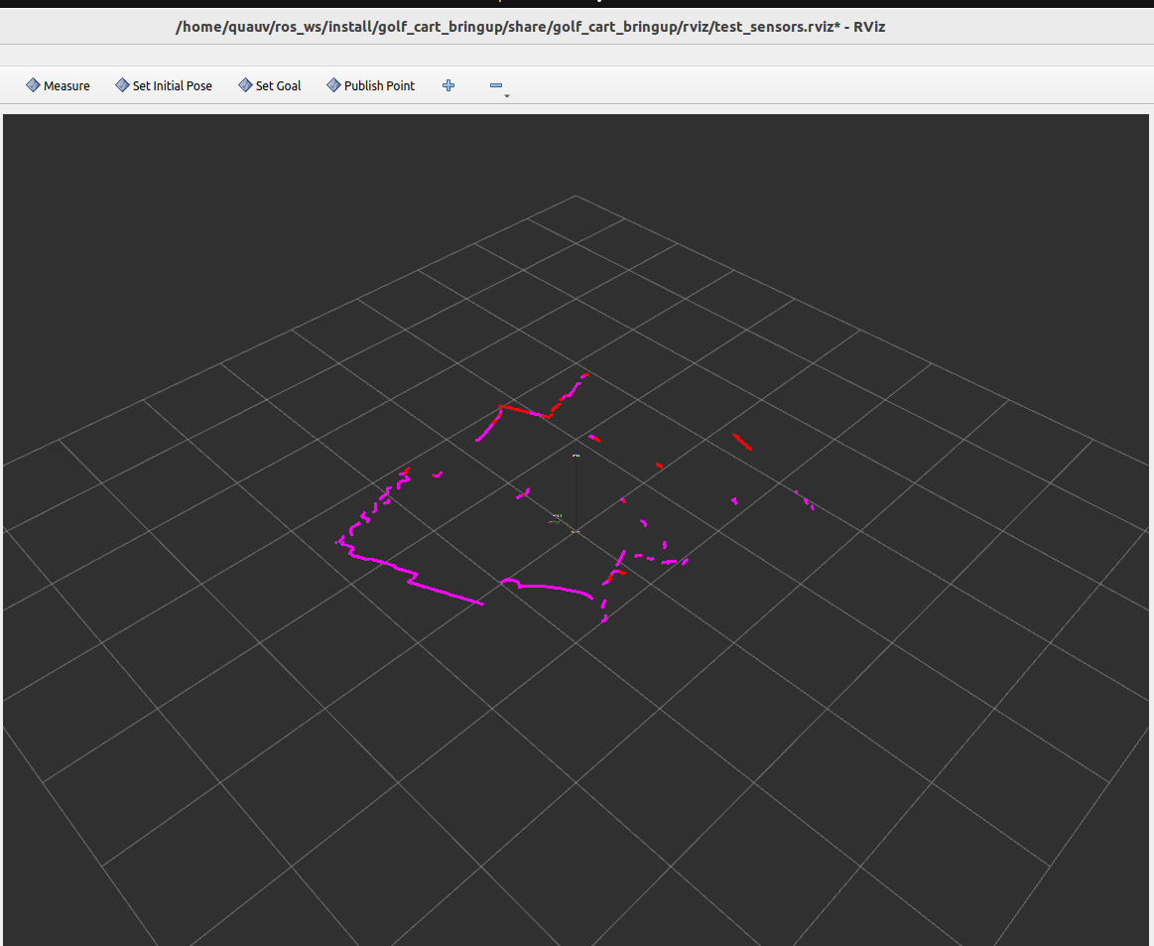
Implementation and Testing phase 2

Slide 25
Results
Approaching the end ……

Slide 26
Results:
Modular System partially Integrated
Perception Pipeline Operational
Stable Power System
Real-Time Obstacle Detection
Motor Control Reliable
Functional Prototype Completed
Notes:
Modular System partially Integrated: subsystems (Jetson, Arduino, sensors, drivers) successfully connected and operational.
Real-Time Obstacle Detection: Ultrasonic sensors achieved responsive emergency stop within 0.2 seconds for objects closer than 30 cm.
Perception Pipeline Operational: camera and LiDAR streams integrated through ROS 2.
Motor Control Reliable: Steering and propulsion via Arduino + MDDS30 & MD20A drivers confirmed to respond correctly to commands.
Stable Power System: Jetson and peripherals powered via 24V battery and buck converter without voltage drops.
Functional Prototype Completed: partiatl System successfully deployed on a small electric vehicle for testing.

Slide 27
Summery & Conclusion
Approaching the end ……
For Real!!!

Slide 28
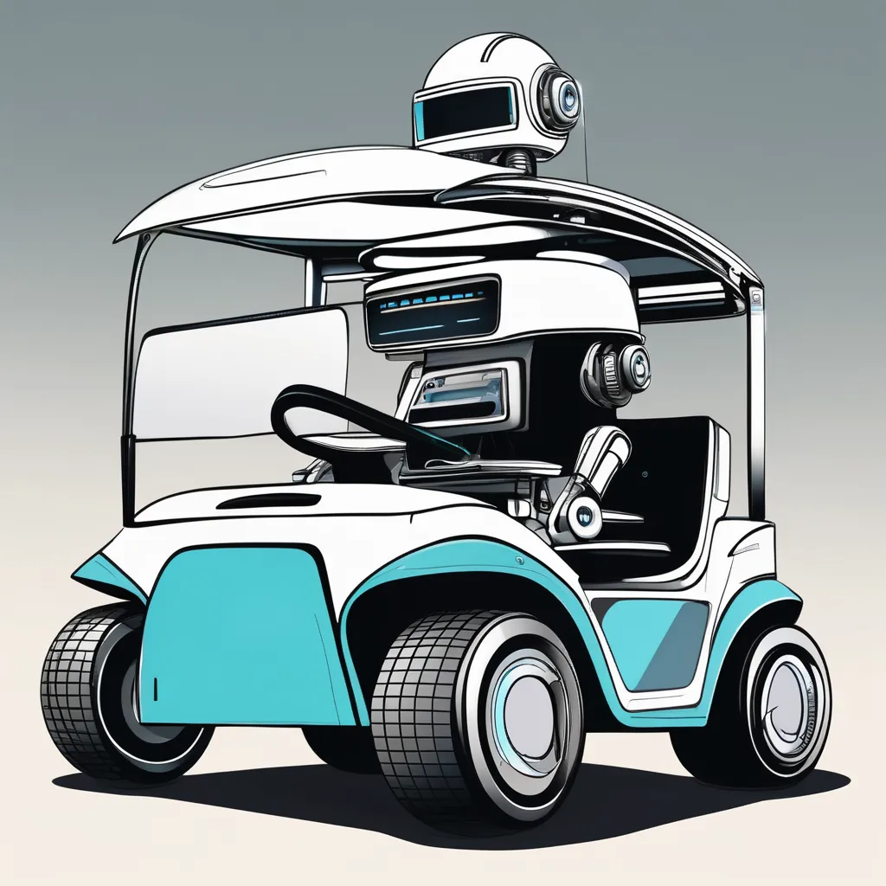
Sustainability Considerations
The autonomous golf cart project successfully achieved major objectives, including system design, partial integration, and real-world testing. Key subsystems like LiDAR mapping, ultrasonic obstacle detection, Jetson Orin NX processing, and ROS 2-based sensor fusion were validated on a mini vehicle at Qatar University. Strengths include a modular design, affordable components, and real-time emergency stopping. Challenges remain in improving path planning, sensor calibration, integrating depth camera, and completing full object detection and navigation. Overall, the project lays a strong foundation for Qatar’s future in smart mobility and autonomous transportation.

Slide 29
Future work
Approaching the end ……
Now this is the true end

Slide 30
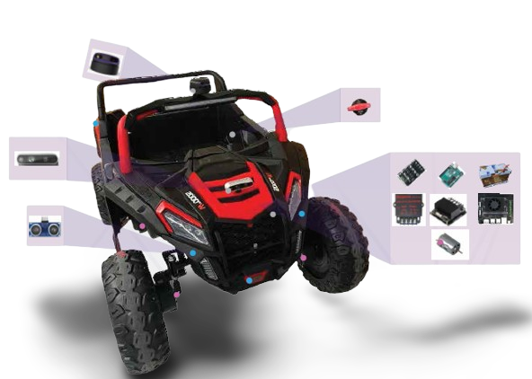
Future work
Transition to a Full-Sized Golf Cart
Enhanced Object Detection and Avoidance
Advanced Path Planning and Navigation
Improved System Calibration and Performance Tuning
Power and Runtime Optimization
Security and Data Handling Enhancements
Expanded Testing Conditions
Reintegrating a depth-sensing camera (such as Intel RealSense) is planned to enhance object detection and depth-based navigation.
Notes:
Transition to a Full-Sized Golf Cart:
While the prototype was validated on a smaller vehicle, the original vision remains to implement this system on a real electric golf cart. This would enable further testing in real environments and demonstrate true operational viability.
Enhanced Object Detection and Avoidance:
Future iterations will focus on completing the YOLOv5-based object detection pipeline and integrating it with dynamic obstacle avoidance logic. These features are critical for real-time decision-making in complex environments.
Advanced Path Planning and Navigation:
Future work will include full autonomous route planning and path execution, with smooth re-routing in the presence of dynamic obstacles.
Improved System Calibration and Performance Tuning:
Fine-tuning sensor positions, synchronizing data streams, and optimizing CPU/GPU usage on the Jetson will improve responsiveness and stability.
Power and Runtime Optimization:
Battery performance will be enhanced through hardware upgrades and load balancing to meet or exceed the targeted 4-hour runtime.
Security and Data Handling Enhancements:
Implementing encryption and secure communication protocols will help meet data security and privacy constraints.
Expanded Testing Conditions:
Future testing will cover variable lighting, terrain, and pedestrian traffic to better simulate deployment conditions and improve reliability.
Reintegrating a depth-sensing camera (such as Intel RealSense) is planned to enhance object detection and depth-based navigation.

Slide 31
Questions ?
And that’s a wrap, folks! Thanks for letting me take you for a ride autonomously, Doctors I do appreciate your time and of course. Any questions?
Please be kind with these future engineers (;

Slide 32
Thank You For Your time!

